Slide 1
Registering for and installing Unity
Pauline Belford

Slide 2
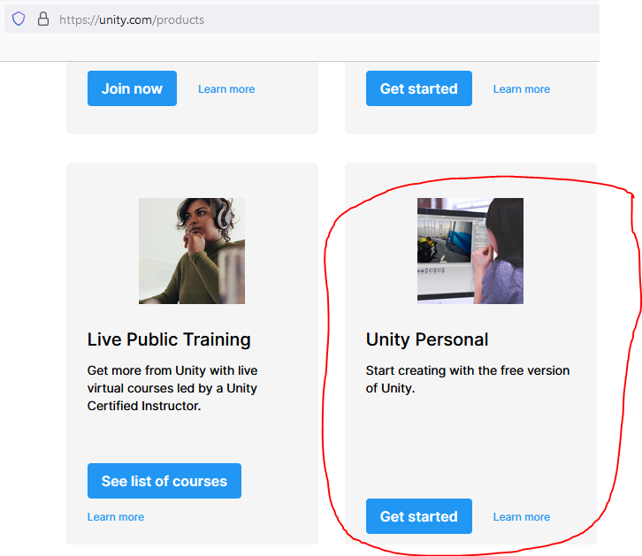
Registering for and downloading Unity
If you do not already have a Unity account, you will need to register for one at https://unity.com
It doesn’t matter which of your email addresses you use. Unity is free for personal use – click on Products, and scroll down to the Unity Personal edition, then click on Get Started.
Download the Unity hub for whichever operating system you are using.
Once Unity Hub is installed, install Unity.
We are using version 2022.1.16f1
Any problems getting Unity? Let me know asap. pauline.belford@chalmers.se

Slide 3
Install Visual Studio Community 2022
You can edit scripts using Notepad if you like, or an alternative IDE to Visual Studio.
However, Visual Studio Community (the free version) is integrated with Unity and has useful features such as colour coding different types of keywords, and use of IntelliSense to auto-complete your code.
You can download this from here: https://visualstudio.microsoft.com/vs/community/
You don’t need to install everything. This guide should help. https://docs.microsoft.com/en-us/visualstudio/gamedev/unity/get-started/getting-started-with-visual-studio-tools-for-unity?pivots=windows
It also shows you how to set Visual Studio as the default editor in Unity, if it is not already.

